Slide 1

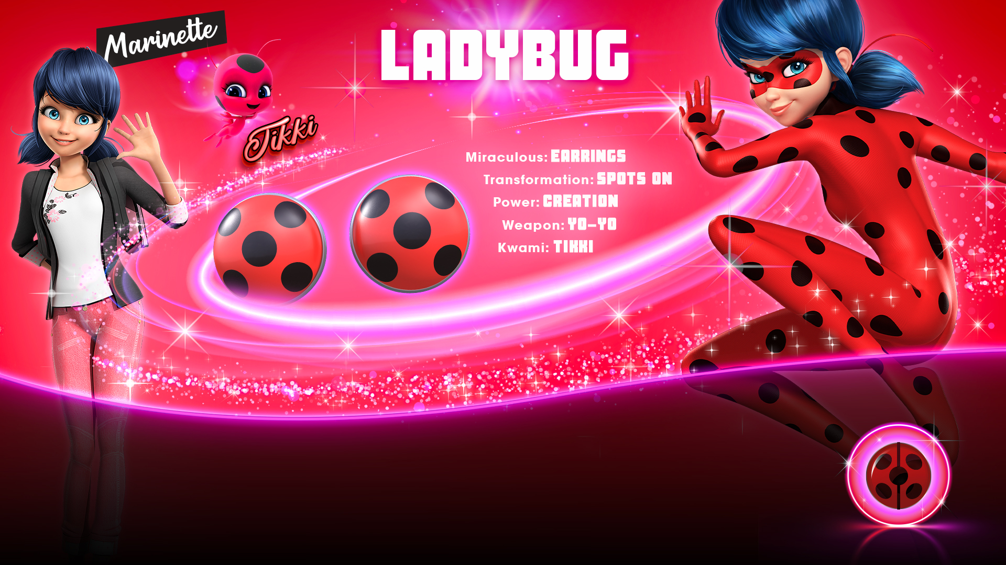
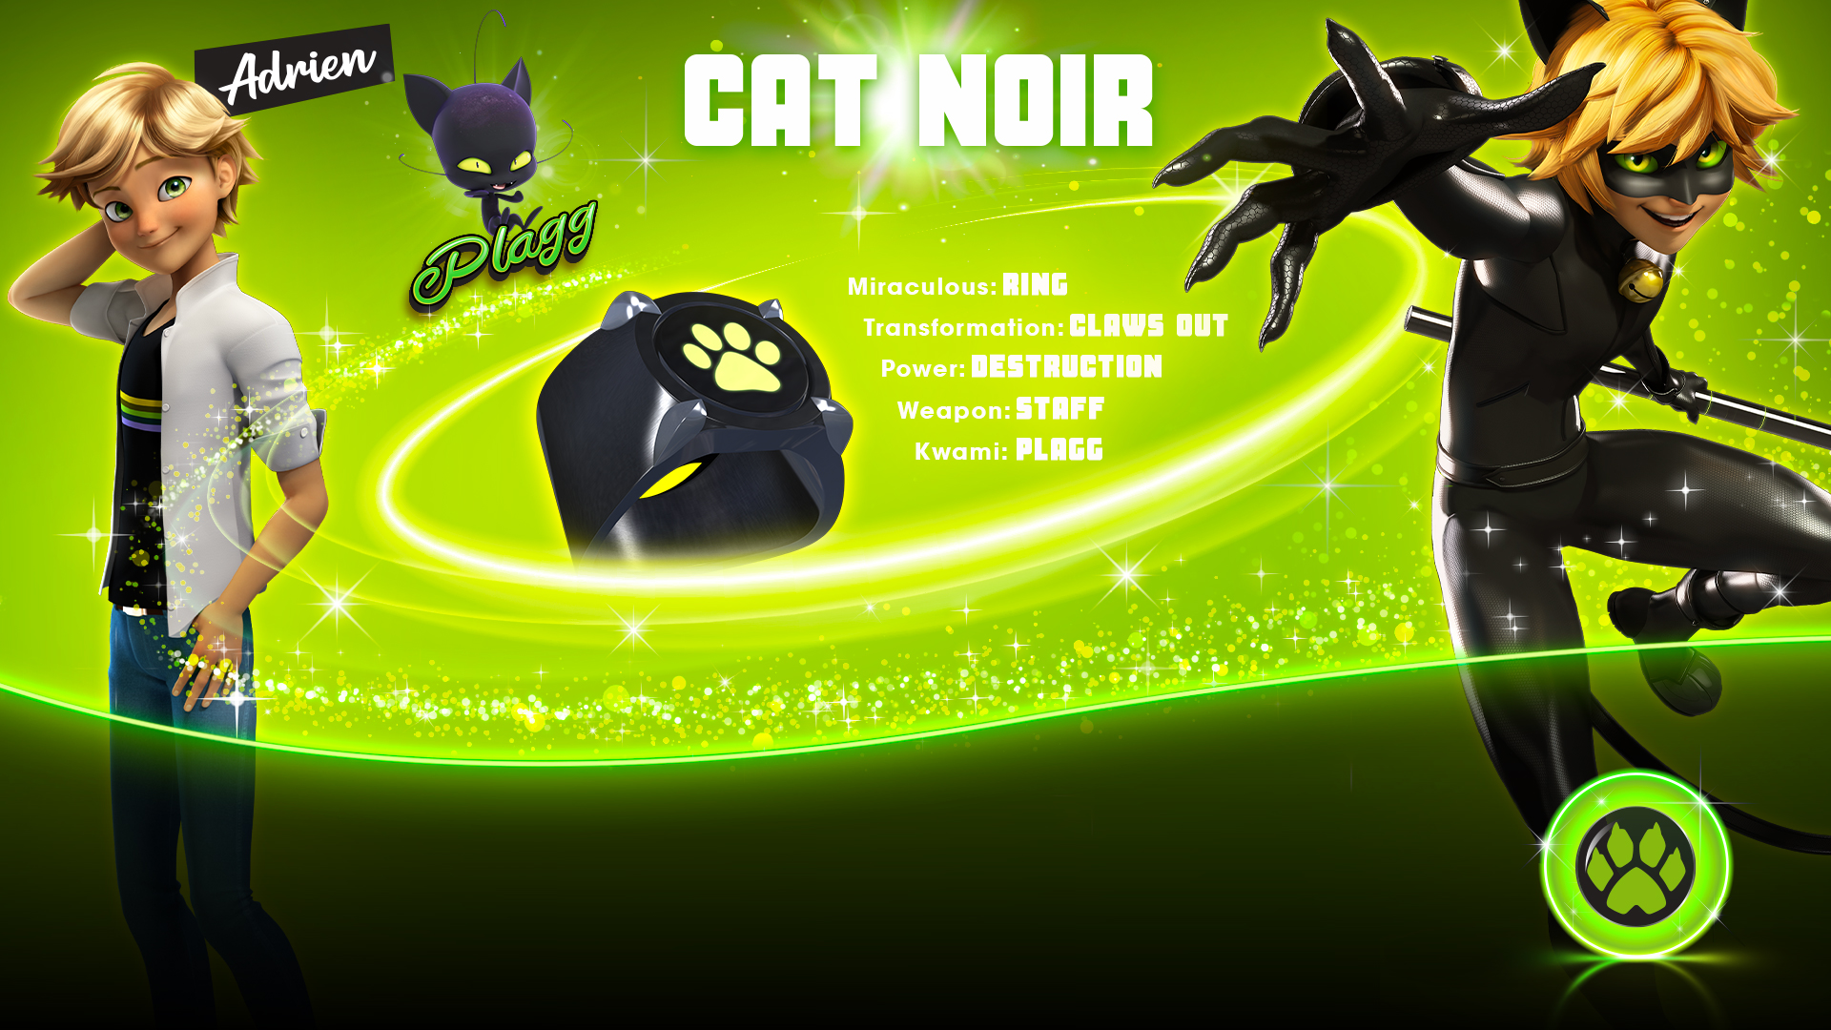
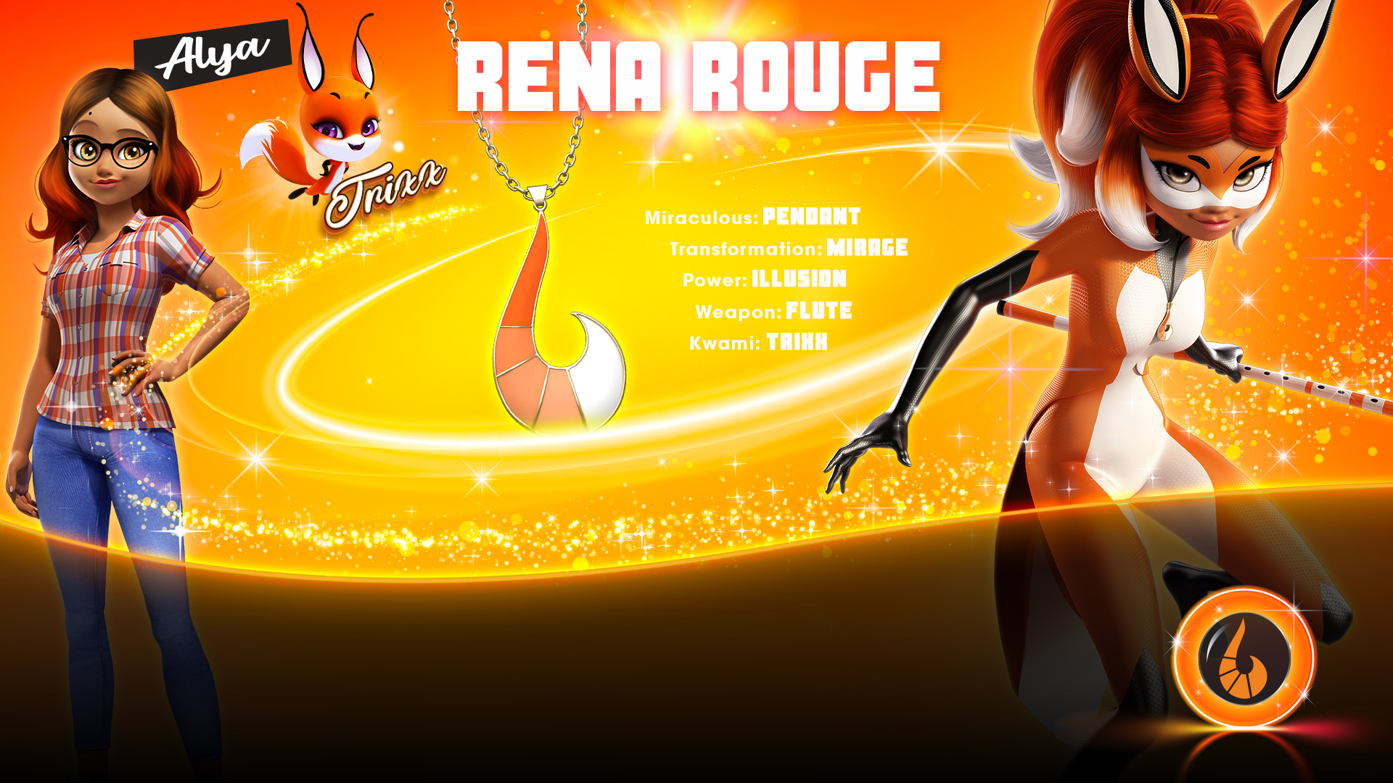
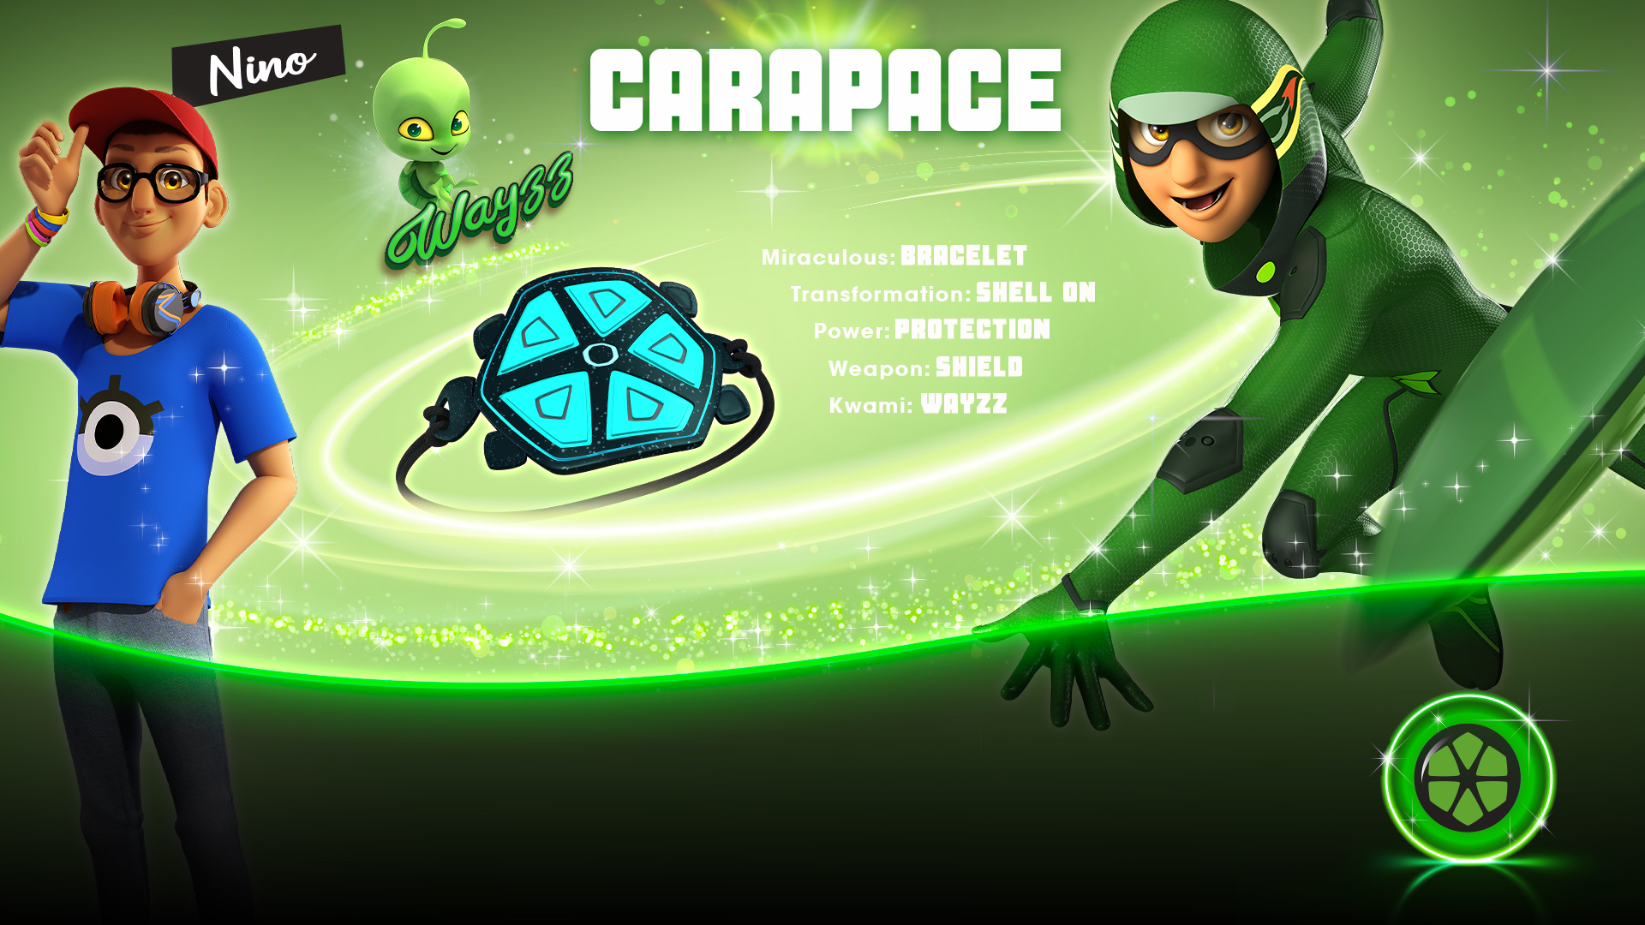
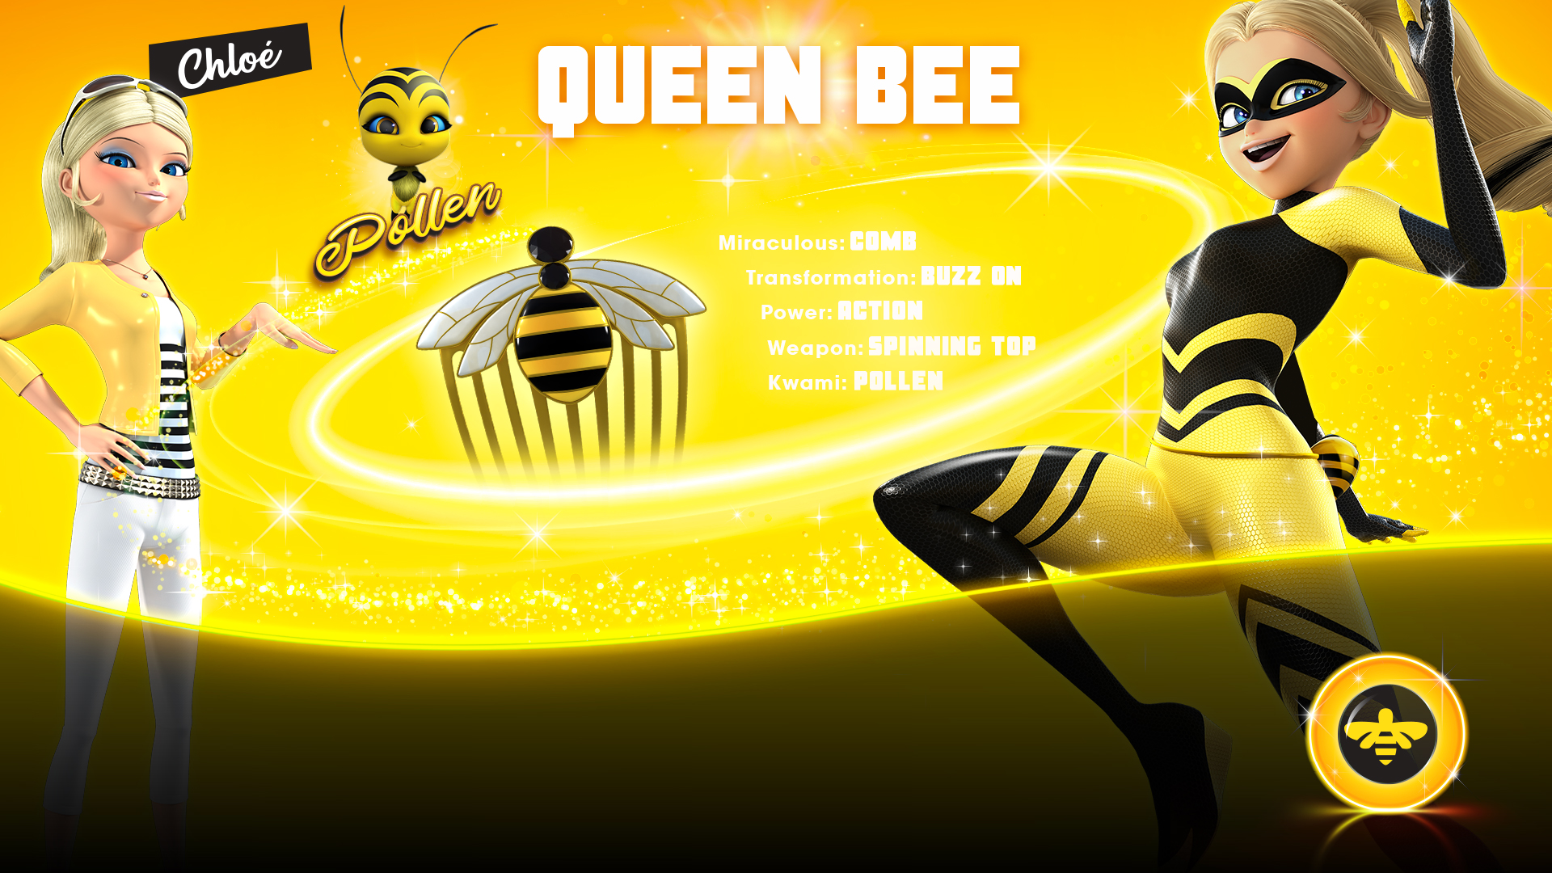
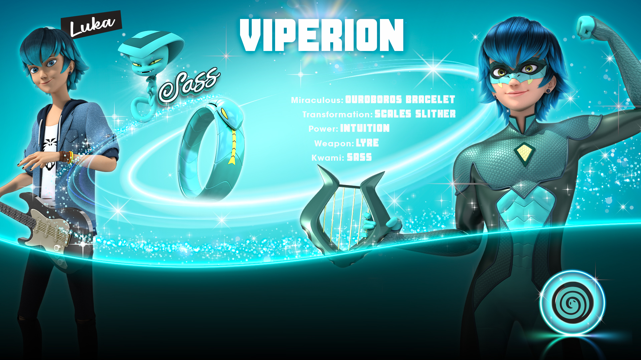
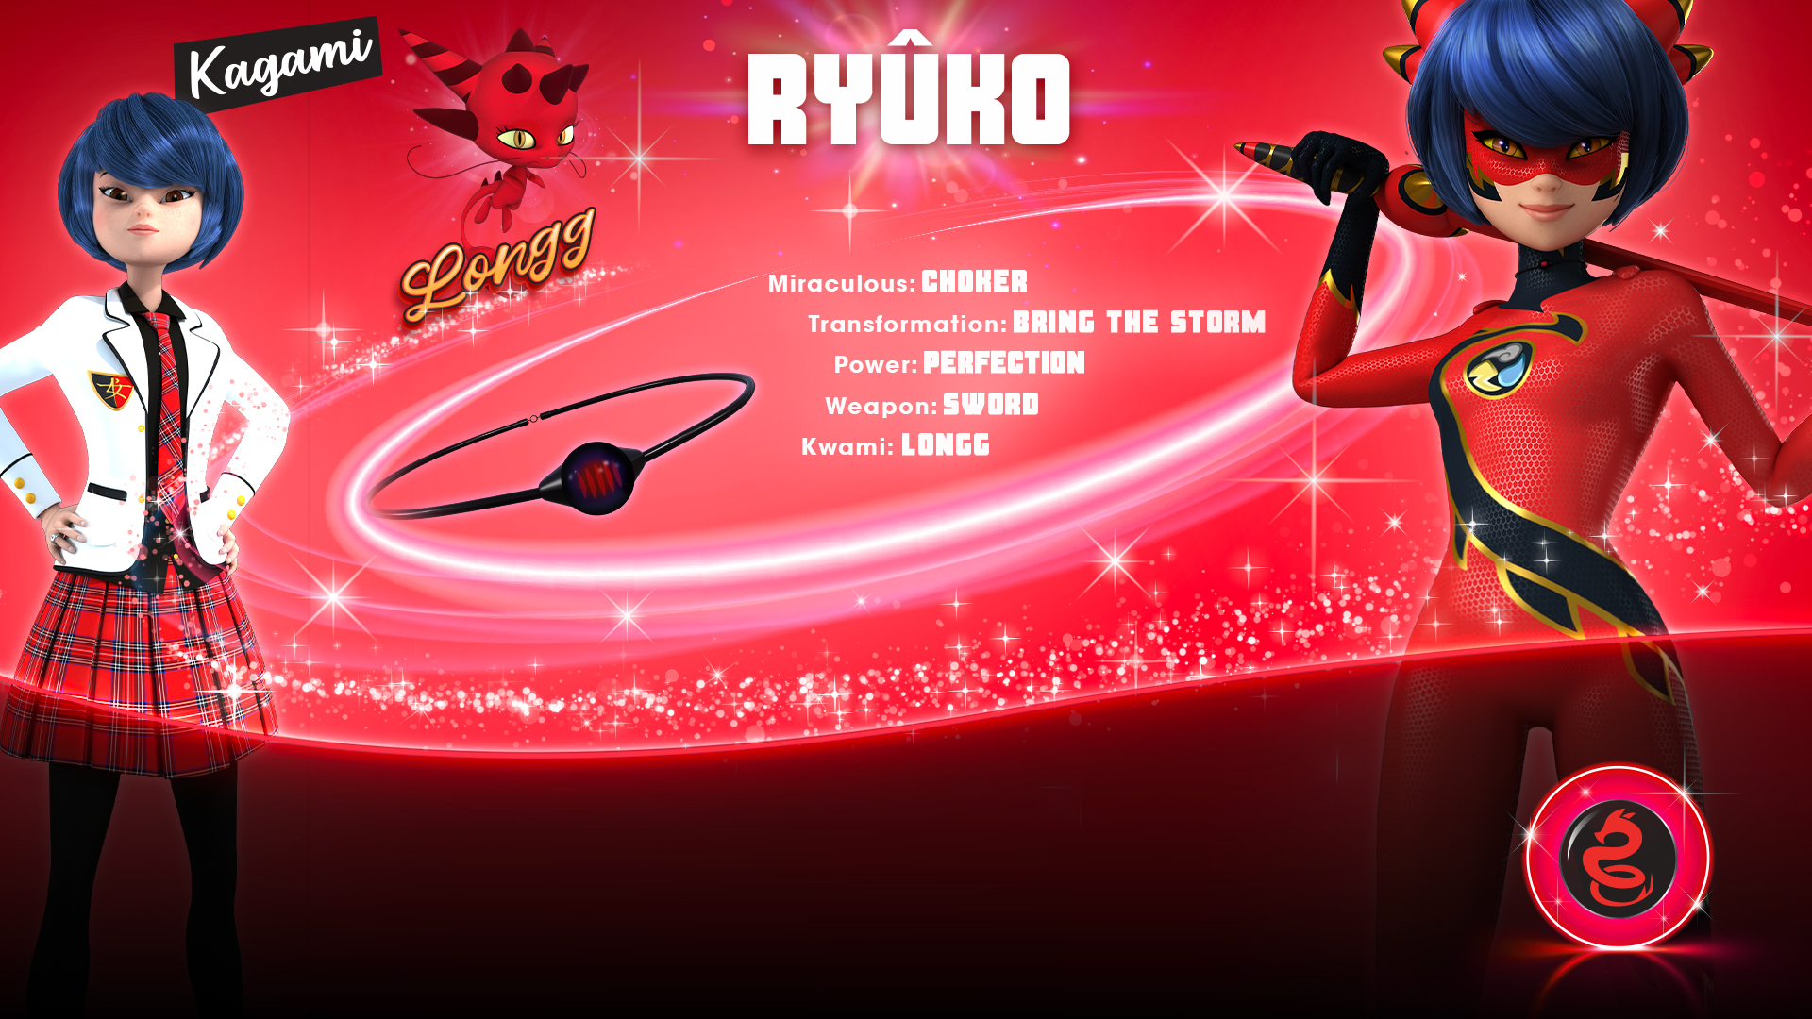

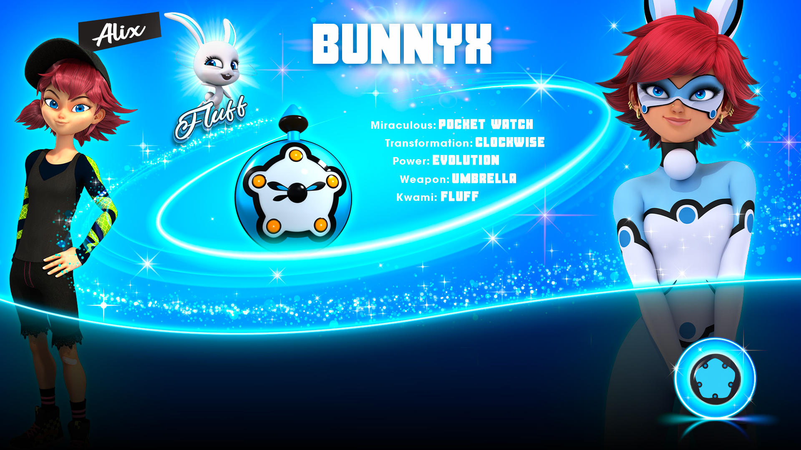







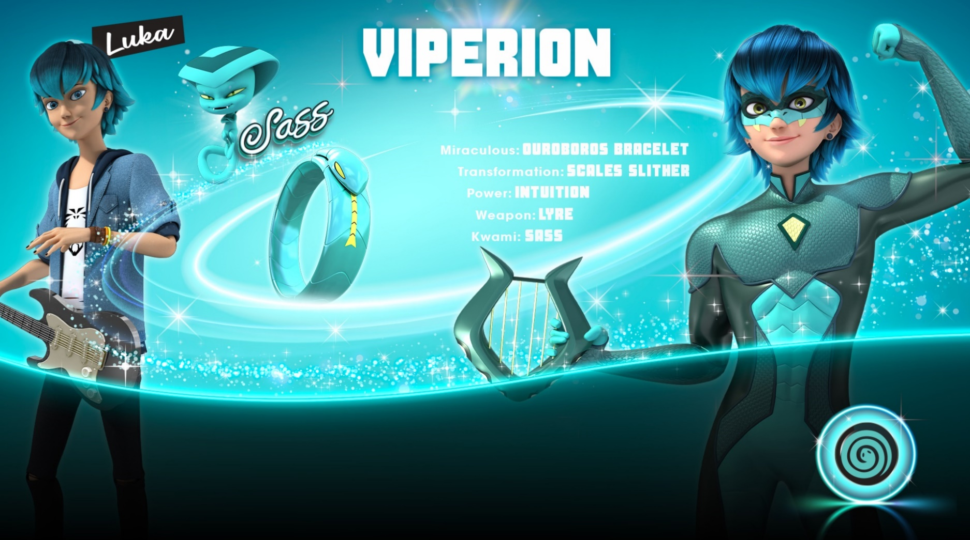
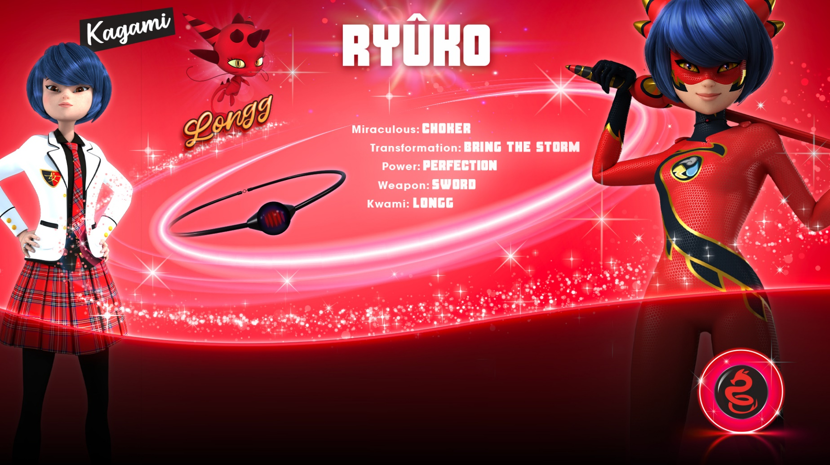
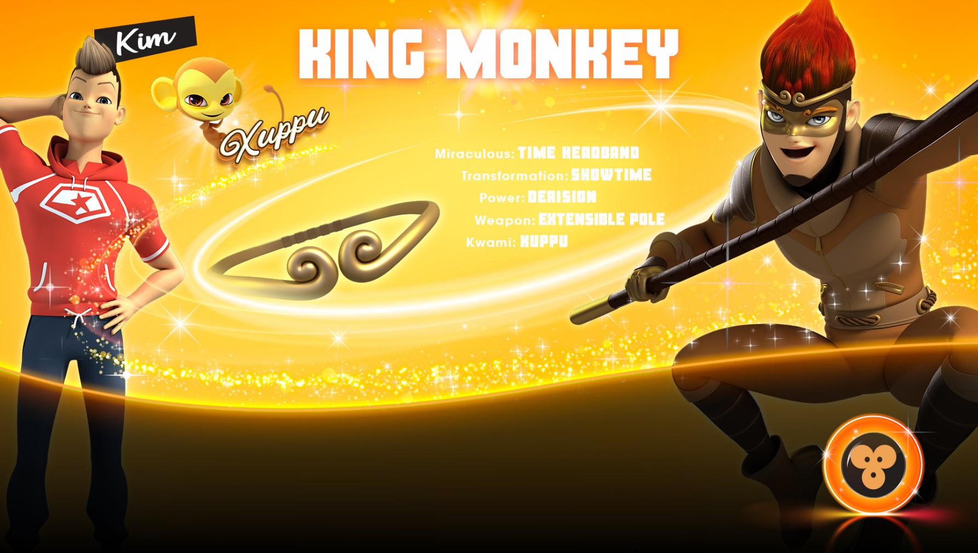

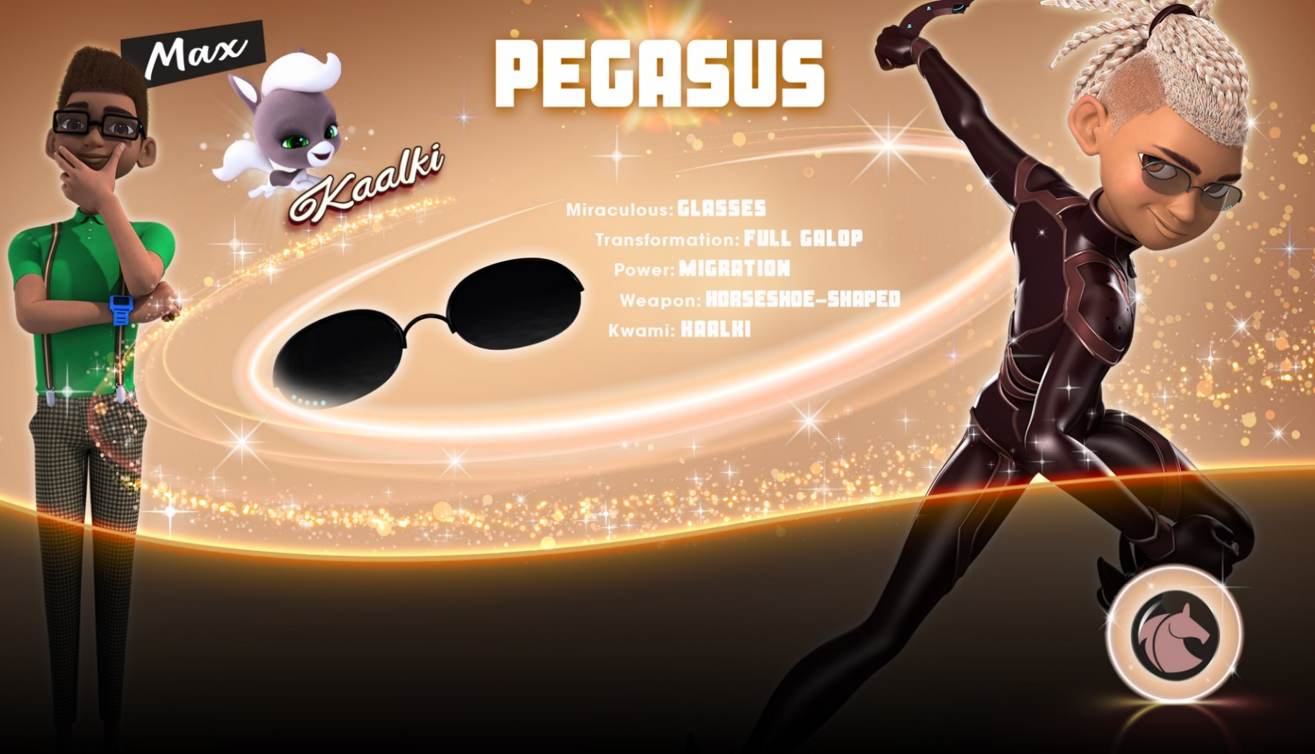
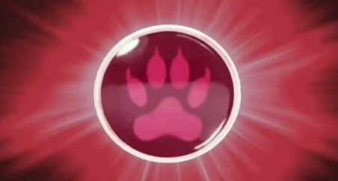



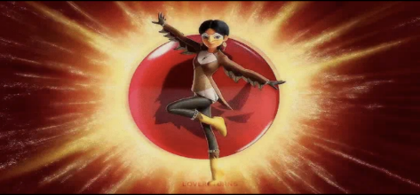
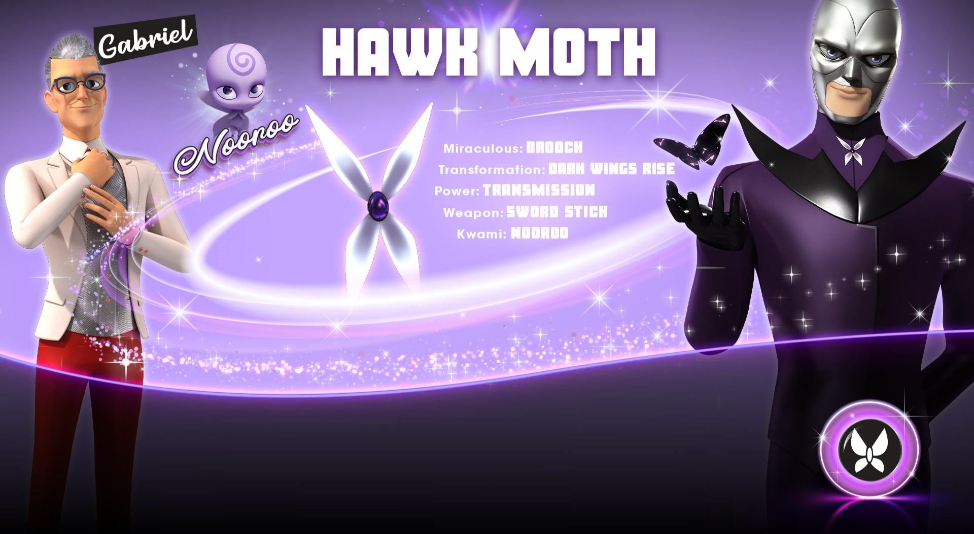
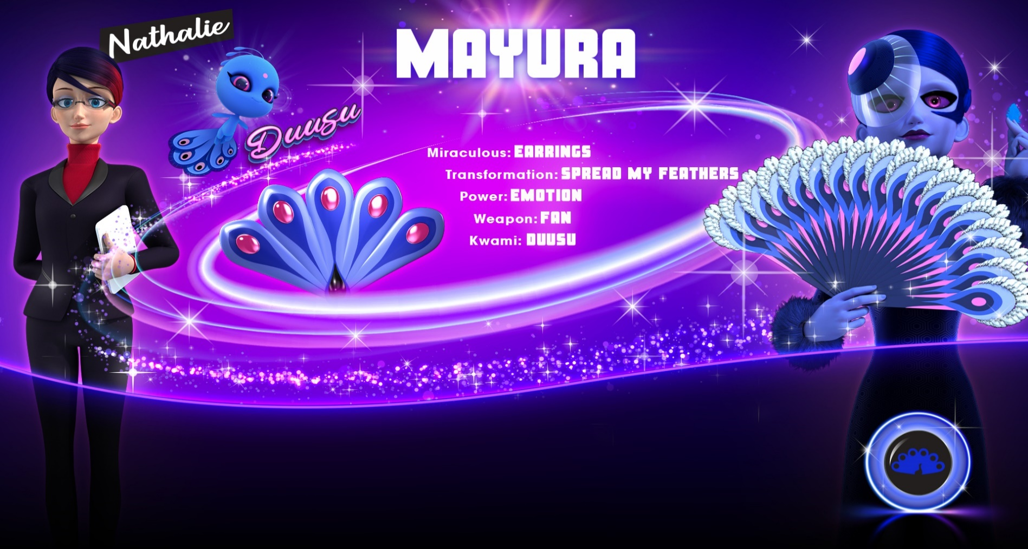


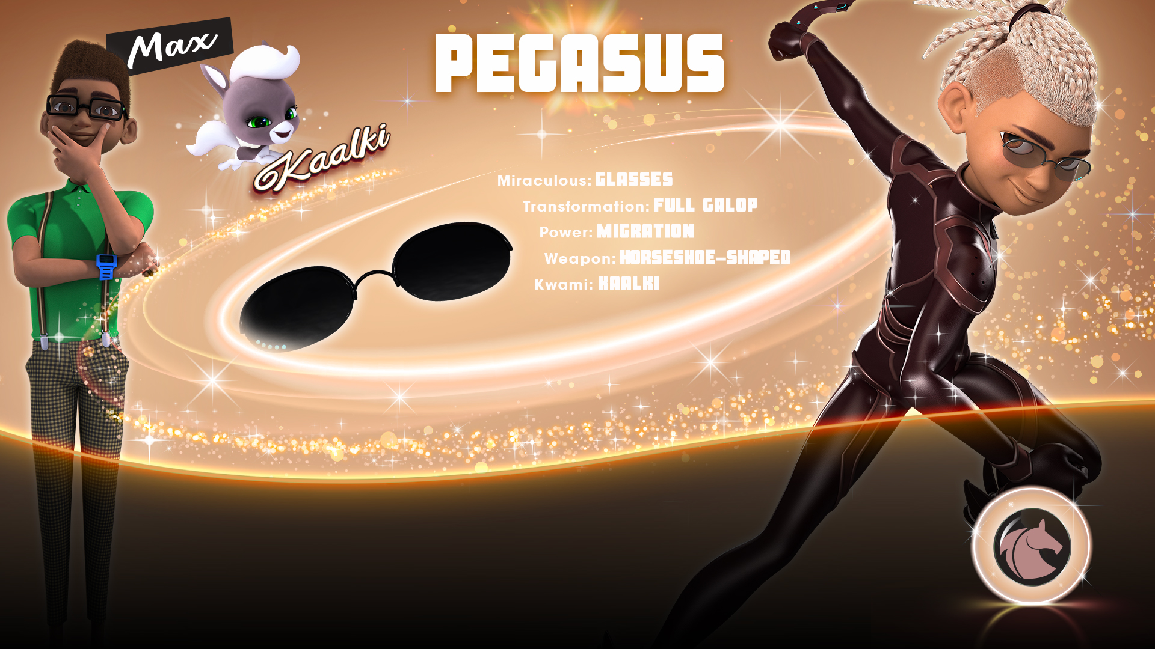
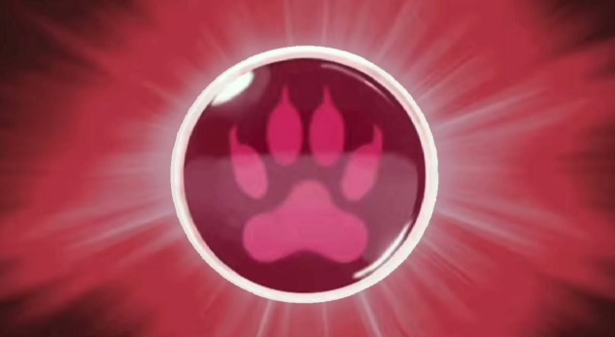





Webpage
- Anushreya Satish

Slide 2

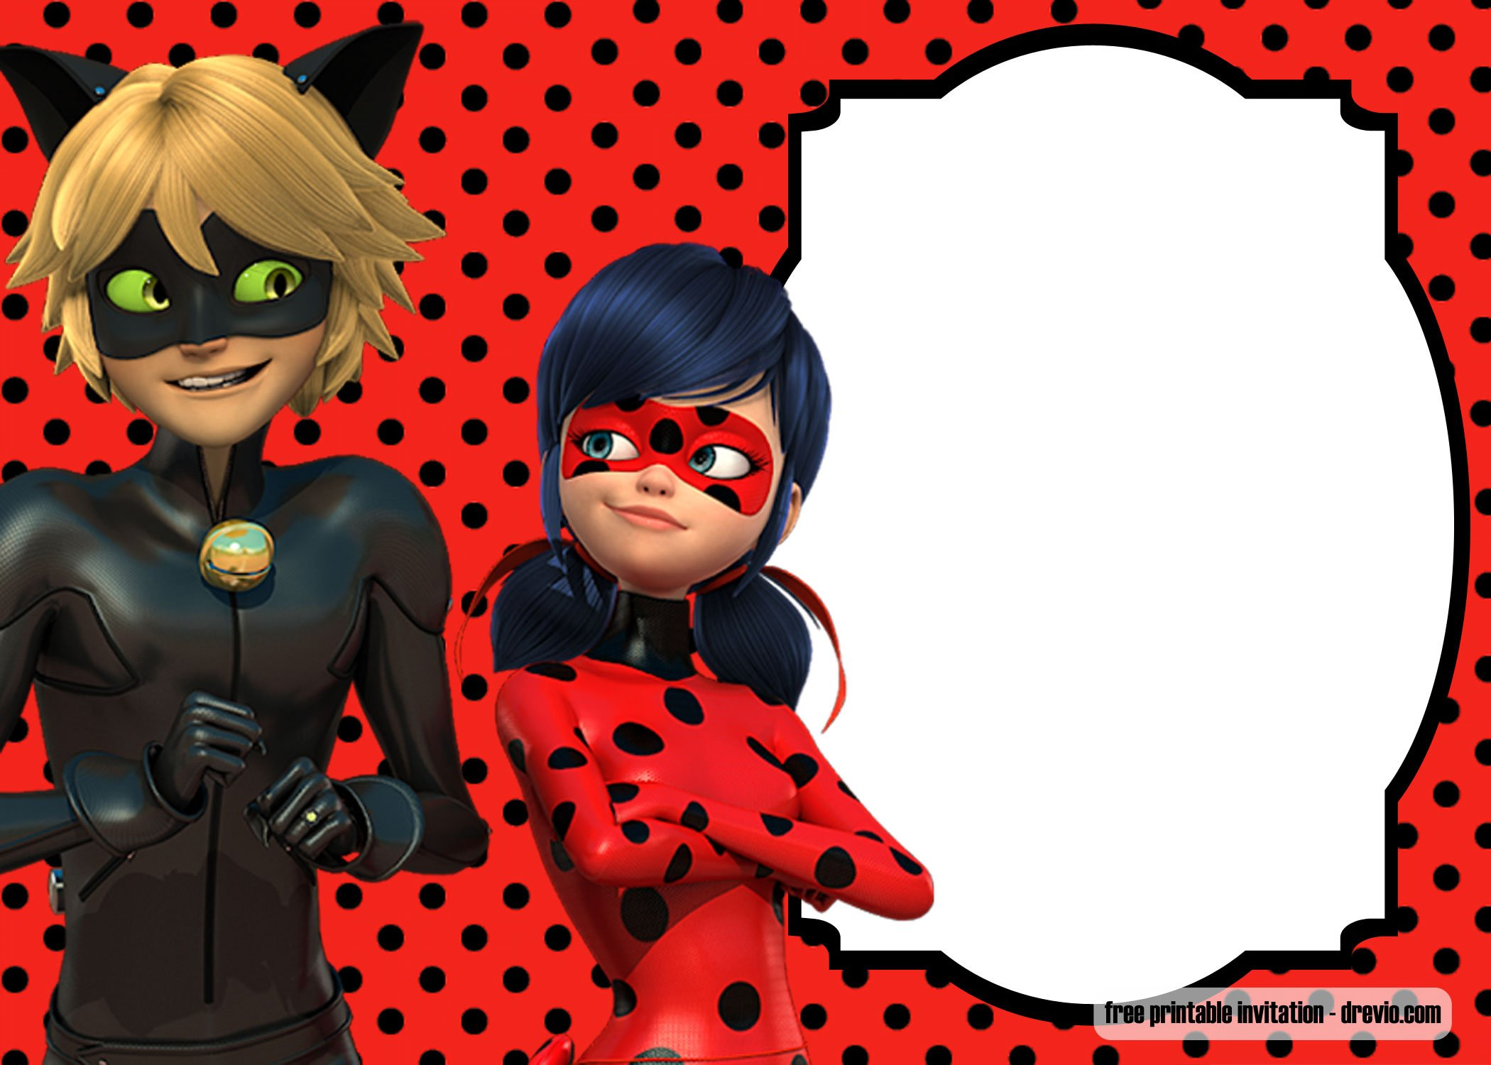

This show teaches us many virtues of life.
Gabriel – Never ever give up even if you’re losing every time.
Cat Noir– Never show other’s that you’re actually broken from inside.
Marinette – The only way evil could triumph is good people doing nothing.
Tikki – The gift doesn’t matter’s the person who is giving it matter’s a lot.
Plagg – Even if it is a tough time you stay cool then only you can get what you want.
Adrien – Happiness can’t be bought from money.
Luka – Listen to your inner music and do exactly what you want and like to do.
Kagami – Respect the sayings of your parents but follow your dreams too.
Nathalie – Be loyal to the people you care.
The Miraculous Heroez Team – Unity is Strength.

Slide 3

Miraculous Secrets
Adrien’s Double life
Alix
Cat Noir as seen by Marinette
Chloe as seen by Marinette
Family
Feelings
Friends
Gabriel
Hawk Moth and the Akumatized villains
Ivan
Kagami as seen by Adrien
Kagami as seen by Marinette
Ladyblog
Ladybug as seen by Adrien
Lila
Luka as seen by Marinette
Marinette and Adrien
Marinette and Alya
Marinette and Fashion
Marinette as seen by Chloe
Marinette in Paris
Marinette’s Double life
Master Fu
Mayura and the sentimonsters
My Birthday Party
Mylene
Nathalie as seen by Gabriel
Nathaniel & Marc
New Heroes
New Powers
Nino
Plagg
Rose
Sabrina
Tikki
Max

Slide 4
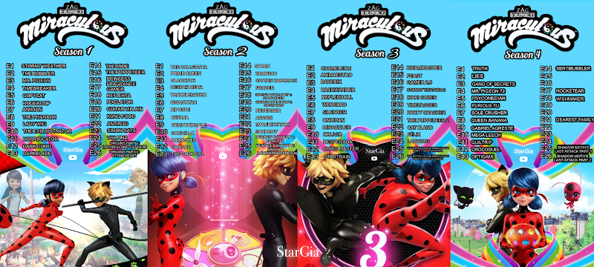
Stormy Weather
The Bubbler
The Pharoah
Lady Wifi
Timebreaker
Mr. Pigeon
The Evillustrator
Rogercop
Copycat
Dark Cupid
Horrificator
Darkblade
The Mime
Kung Food
Gamer
Animan
Antibug
The Puppeteer
Reflekta
Guitar Villain
Pixelator
Princess Fragrance
Simon Says
Volpina
Ladybug & Cat Noir Origins I
Stoneheart Origins II
A Christmas Special
The Collector
Despair Bear
Prime Queen
Befana
Riposte
Robustus
Gigantitan
The Dark Owl
Glaciator
Sapotis
Gorizilla
Captain Hardrock
Zombiezou
Syren
Frightningale
Troublemaker
Anansi
Sandboy
Reverser
Frozer
Style Queen : Queen’s Battle I
Queen Wasp : Queen’s Battle II
Malediktator
Catalyst : Heroes Day I
Mayura : Heroes Day II
Backwarder
Weredad
Chameleon
Animaestro
Bakerix
Silencer
Oblivio
Stormy Weather 2
Reflekdoll
Oni-Chan
Miraculer
The Puppeteer 2
Desperada
Startrain
Kwamibuster
Feast
Ikari Gozen
Timetagger
Party Crasher
Gamer 2.0
Cat Blanc
Felix
Ladybug
Christmaster
Heart Hunter : The Battle of Miraculous I
Miracle Queen : The Battle of Miraculous II
Truth
Lies
Gang of Secrets
Mr. Pigeon 72
Psychomedian (N.A)
Furious Fu
Sole Crusher
Queen Banana
Gabriel Agreste (N.A)
Mega Leech
Guitrip
Crocoduel
Optigami
Sentibubbler
Glaciator 2 (N.A)
Hack-San
Rocketear
Wishmaker
Simpleman
Qilin (N.A)
Dearest Family (N.A)
Ephemeral (N.A)
Kuro Neko (N.A)
Penal Team (N.A)
Risk (N.A)
Strike Back (N.A)

Slide 5
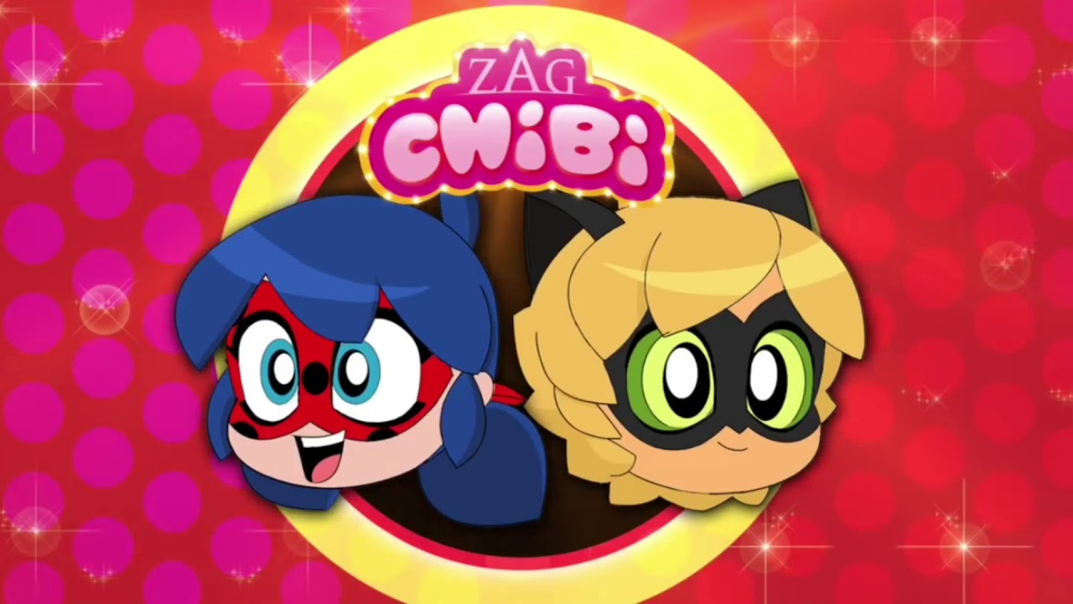
Rooftop Dinner
Catnip Fragrance
The Chase
Curiosity Kicked the Cat
Cutest Cat Fight
Fatal Posy
Scary Bug
Neck Race (N.A)

Slide 6

New York : United Heroez
Shanghai : The Legend of Ladydragon
London (N.A)
Africa (N.A)
Brazil :Rio De Janeiro (N.A)
Japan (N.A)
Specials –
Football / World Cup Special
Barrier Gestures
Exclusive Penpals

Slide 7
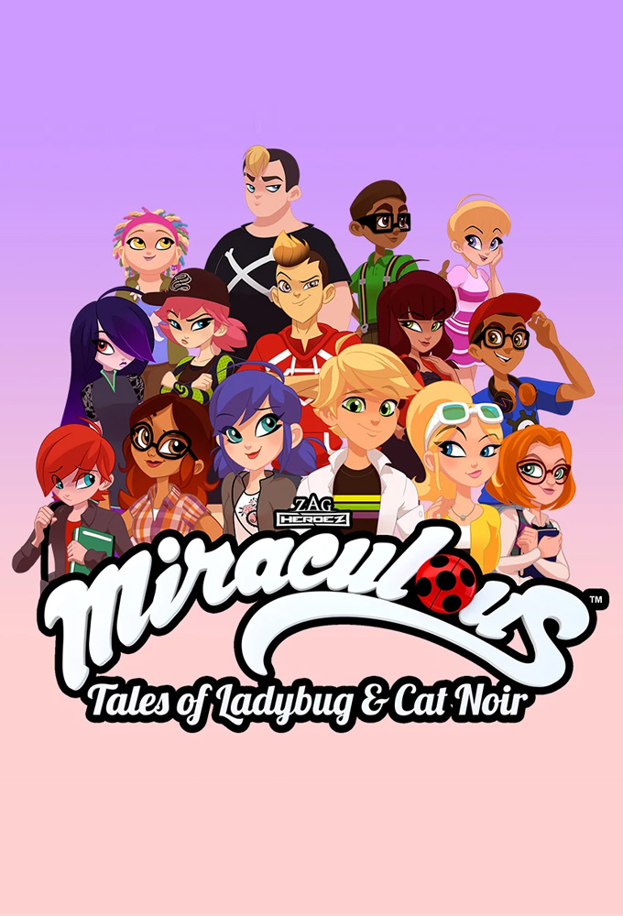
Songs
Miraculous
Adrienette Dance
In the rain
Little Kitty on the roof
The Boy that I secretly love
Cat of the night
All have the right
Marinette in the bakery
I am Santa Claws
Christmas theme
S4 theme
Miraculous Christmas
Smelly Wolf
Tales from Paris
Repition
Inspiration
Busy Day
Homework Essay
The Notebook
Movie
Ladybug & Cat Noir : Awakening
Spoiler songs from the movie
(names not confirm)
Wall Between Us
The Last Dance
An Immense Power
Leave me alone
In love
A magic world
He smiled
Never Surrender

Slide 8
New Year New Updates 2022
Each Section has it’s own unique favicon.
Episodes in Google Drive to make sure it’s safe.
New title and favicon style.
Soundtracks & songs in google drive .
External Links for Miraculous Sessions like pen pals & subscription boxes.
More learning from the show.
Episode List update.
News Section, where you’ll get spoilers , release dates & news about the show.
Update in information about characters.
Renlings will have their own separate section.
Felix , Chloe, Lila, Sabrina, Nathaniel, Ivan & Marc will be added.
New game by me will be added, “The Battle of Miraculous”.
New Quiz by me with all the seasons we have got till now.
New Webpage Thumbnail, with a special look.
Get a facts section in the webpage to unravel the secrets of Miraculous.
Official game download link will be available for android.
Roblox game link available as well.
Official Website & Youtube Channel link will be available.
Sample Pen Pal Session Letter available in French, translation will be , it will be downloadable & printable.
Each season & specials will have a different section so it won’t be confusing when searching for an episode.
New design of the website to make it more adaptable.
Episode End Card available in the episode section.

Slide 9


